Slide 1

EmPhAsIS Empowering Pharmacists in Asthma management through Interactive SMS
Baseline Procedures:
Intervention Pharmacy, Next Steps
emphasis.core.ubc.ca
Click for more information

Slide 2
EmPhAsIS Empowering Pharmacists in Asthma management through Interactive SMS
To review how to recruit and screen a potential study participant,
please see the previous mini-webinar on:
“Baseline Procedures: Recruiting and Screening Patients”
To review how to consent and enroll a potential study participant,
please see the previous mini-webinar on:
“Baseline Procedures: Consenting and Enrolling Patients”

Slide 3



1. Provide Asthma Education to Patient
+
As this is a real-world (‘pragmatic’) clinical trial, provide education according to your own practice
Educational resources on asthma available website for both patients and pharmacists

Slide 4
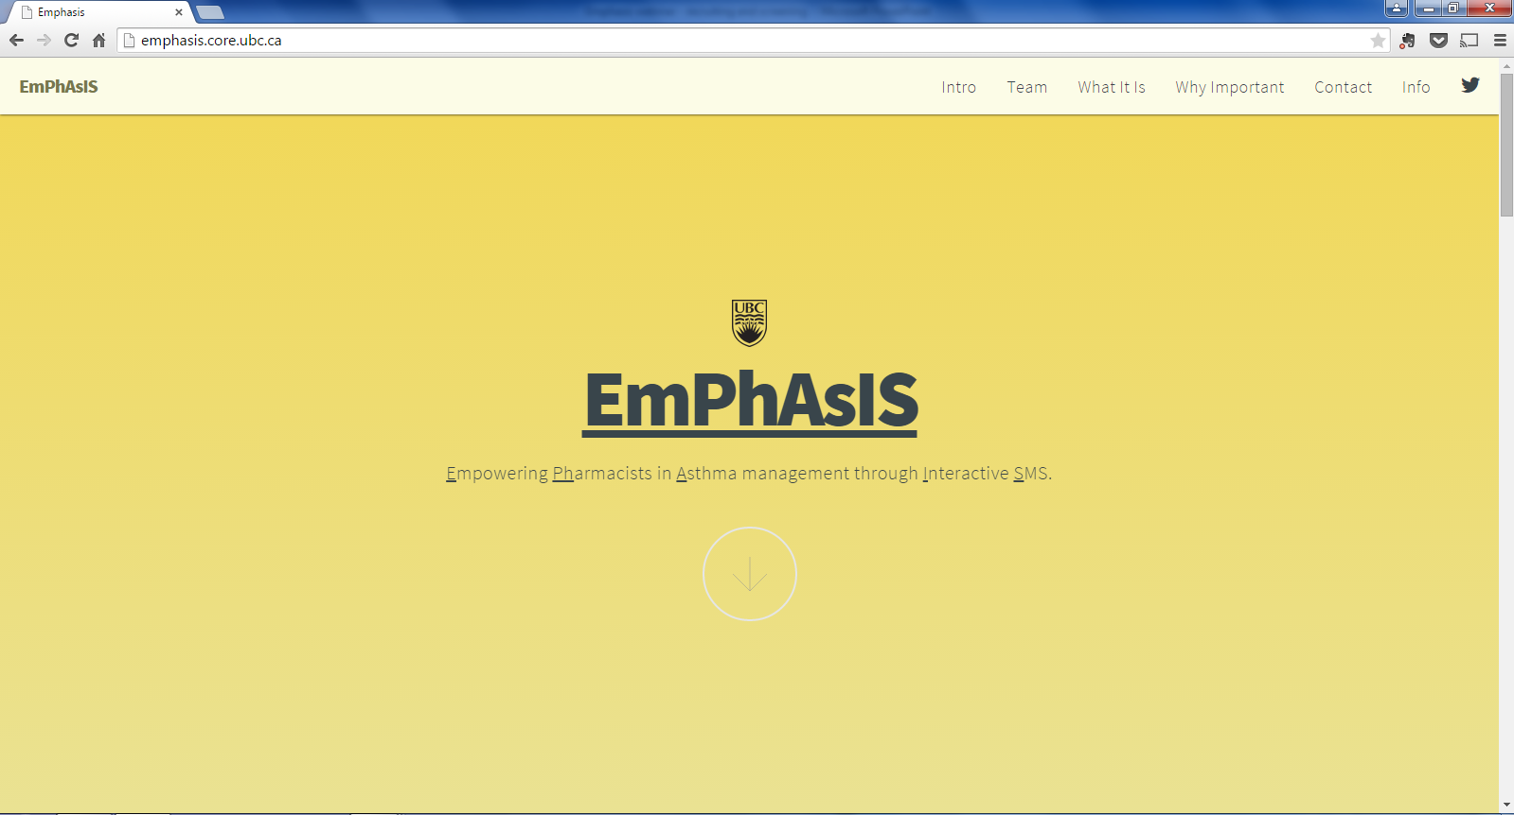
2. Registering Patients on WelTel
+
Go to the EmPhAsIS study website: emphasis.core.ubc.ca
Click on Info

Slide 5
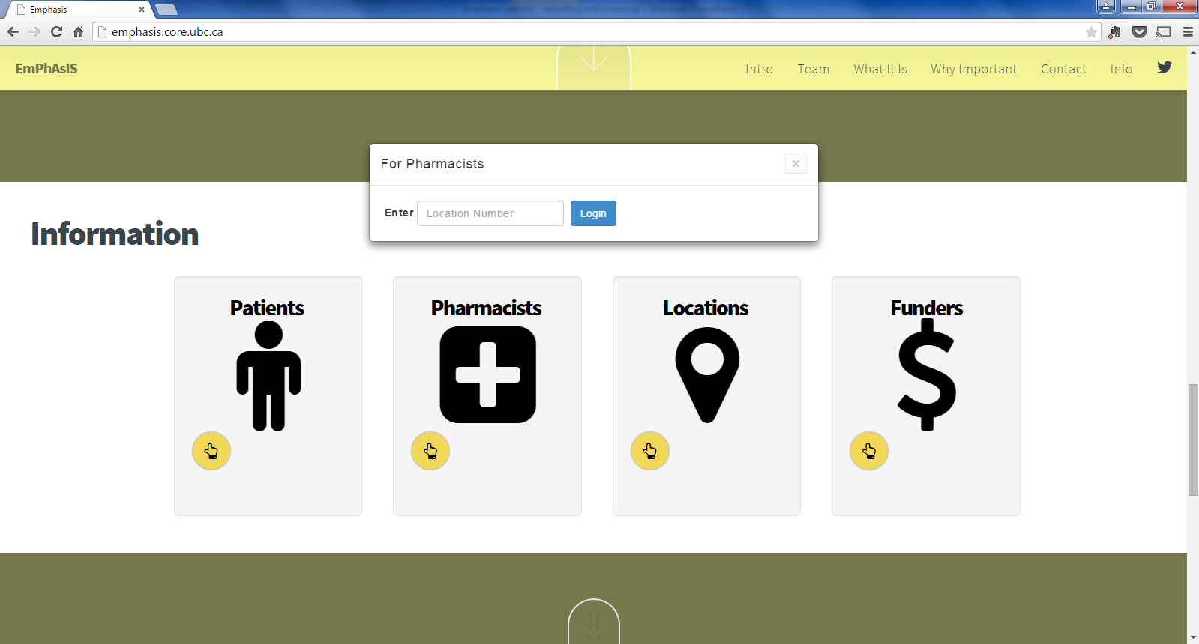
2. Registering Patients on WelTel
+
Enter your Username
(i.e. phar007)
Click on Pharmacists

Slide 6
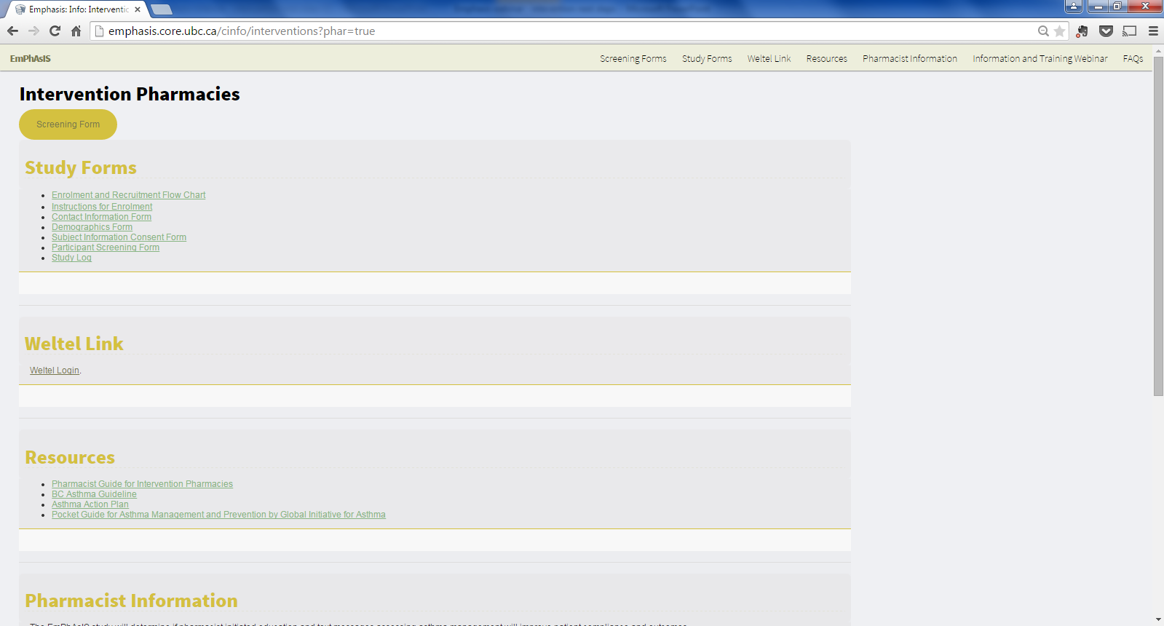
2. Registering Patients on WelTel
+
Click on
WelTel Login

Slide 7
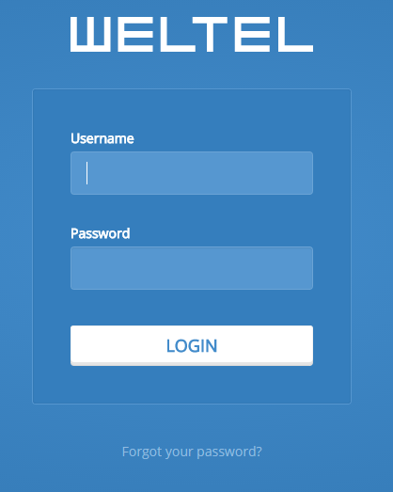
2. Registering Patients on WelTel
+
Enter Username
(i.e. phar007)
Enter password (created by you)

Slide 8
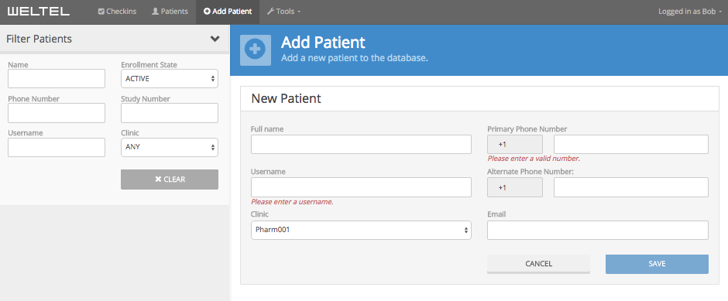
2. Registering Patients on WelTel
+
1. Click on Add Patient
4. Must be a cell phone number
2. Enter full name
3. Enter Patient Study ID
5. Click on ‘Save’ after completing the required fields
6. Patient will receive first text message within a few seconds/minutes

Slide 9
3. Initiating Text Messages
+
Once patient is registered into the WelTel platform, they will receive a text message within seconds to minutes
This is the same text message that they will receive on the first Monday of every month for the following 12 months
Txt 1-6 for: I follow my asthma medication plan.
AGREE: Completely=1;
Mostly=2, Somewhat=3;
DISAGREE: Somewhat=4;
Mostly=5, Completely=6

Slide 10
4. Inform Patient of “Next Steps”
+
1. Text messages
Welcome text
at pharmacy
0
1
Patients receive text on the 1st Monday of each month
*Based on patient responses, they may receive up to 5 texts
2
3
Txt 1-6 for: I follow my asthma medication plan.
AGREE: Completely=1,
Mostly=2, Somewhat=3;
DISAGREE: Somewhat=4,
Mostly=5, Completely=6
4
5
Month
6
7
9
10
11
12

Slide 11

4. Inform Patient of “Next Steps”
+
1. Text messages
Welcome text
at pharmacy
0
1
Patients receive text on the 1st Monday of each month
*Based on patient responses, they may receive up to 5 texts
2
3
Txt 1-6 for: I follow my asthma medication plan.
AGREE: Completely=1,
Mostly=2, Somewhat=3;
DISAGREE: Somewhat=4,
Mostly=5, Completely=6
4
5
Month
6
7
9
10
11
12
2. Monthly Follow-up
Telephone follow-up
with patient
As Needed
Based on patient response to the text messages, you may need to follow-up with patients to address potential problems with adherence

Slide 12

4. Inform Patient of “Next Steps”
+
1. Text messages
Welcome text
at pharmacy
0
1
3. Follow up from the research team
Month 0
6
12
Patients receive text on the 1st Monday of each month
*Based on patient responses, they may receive up to 5 texts
2
3
Txt 1-6 for: I follow my asthma medication plan.
AGREE: Completely=1,
Mostly=2, Somewhat=3;
DISAGREE: Somewhat=4,
Mostly=5, Completely=6
4
Patient receives questionnaires, via the internet or phone, to see how they are doing
5
Month
6
7
9
10
11
12
2. Monthly Follow-up
Patients will receive a $25 honorarium at the end of the study
Telephone follow-up
with patient
As Needed
Based on patient response to the text messages, you may need to follow-up with patients and help them with their asthma medication plan

Slide 13
5. Provide Patient with Resources
+
Before the patient leaves the pharmacy, make sure they have:
1 copy of the Participant Guide
1 copy of their signed Subject Information and Consent Form (stapled copy)
Magnet
Remind patients they are able to visit the EmPhAsIS website for more information and resources for patients

Slide 14
Congratulations!
You have now successfully registered a patient into the WelTel platform and the patient will now receive monthly text messages following their adherence!
For monthly follow-up procedures for pharmacists,
please see next mini-webinar on:
“Follow-up Procedures: Intervention Pharmacy, Monthly Follow-up and WelTel Platform”

Slide 15
EmPhAsIS Empowering Pharmacists in Asthma management through Interactive SMS
Questions?
Please do not hesitate to contact us
Dr. Mary De Vera at 604-827-2138 (mdevera@mail.ubc.ca)
Research Coordinator (Louise) at 604-827-1567 (louisega@mail.ubc.ca)
Fax: 604-827-4014
Mailing Address
2405 Wesbrook Mall, Vancouver BC, Canada V6T 1Z3

